Slide 1
Backend as a Service (BaaS)
Pravin Y Pawar

Slide 2
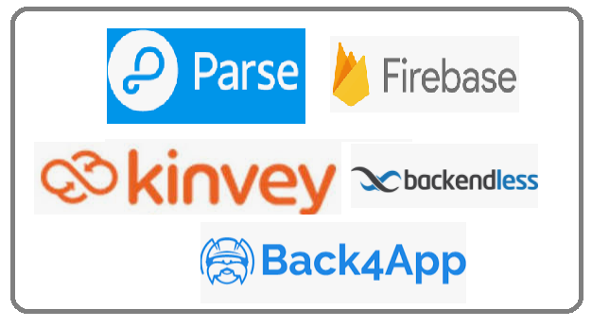
BaaS
is a platform that
automates backend side development
takes care of the cloud infrastructure
App teams
outsource the responsibilities of running and maintaining servers to a third party
focus on the frontend or client-side development
Provides a set of tools to help developers to create a backend code speedily
with help of ready to use features such as
scalable databases
APIs
cloud code functions
social media integrations
file storage
push notifications

Slide 3
Apps suitable for BaaS
Social media apps
alike Facebook, Instagram
Real-time chat applications
alike WhatsApp
Taxi apps
alike Uber, Ola
Video and music streaming apps
similar to Netflix
Mobile games
Ecommerce apps

Slide 4
Why Backend as a service?
A BaaS platform solves two problems:
Manage and scale cloud infrastructure
Speed up backend development
Business reasons to use BaaS:
Reduce time to market
Save money and decrease the cost of development
Assign fewer backend developers to a project
Outsource cloud infrastructure management
Technical reasons to use BaaS:
Focus on frontend development
Excludes redundant stack setup
No need to program boilerplate code
Standardize the coding environment
Let backend developers program high-value lines of code
Provides ready to use features like authentication, data storage, and search

Slide 5
Pros-Cons
Advantages
Speedy Development
Reduced Development price
Serverless, and no need to manage infrastructure
Disadvantages
Less flexible as compared to custom coding / deployments
Less customization in comparison to a custom backend
Vendor lock-in possible

Slide 6
Thank You!
In our next session:

